Slide 1
Study Unit 3 Arrays and Plots

Slide 2
Array Management with NumPy

Slide 3
NumPy Package
Compound data such as lists, tuples, or dictionaries are one-dimensional.
Arrays should be used to store multidimensional data.
All values must be of the same type, typically numeric values or strings.
NumPy is the most common package in Python to work with arrays.

Slide 4
Install and Import NumPy Package
Use the import statement to load “numpy” package in our program.
The most common alias for “numpy” is “np”.
import numpy as np

Slide 5
Create Arrays
Use array() function to create n-dimensional NumPy arrays (ndarray).
Data in the array() function are stored in various regular Python lists.
Each list corresponds to a row of the array.
Number of elements in each list must be identical.
All lists in the array() function, separated by commas, must be wrapped by a pair of outer square brackets.
Each direction of an array is called an axis.
array_name = np.array([[list1_data1, list1_data2, …],
[list2_data1, list2_data2, …], …])

Slide 6

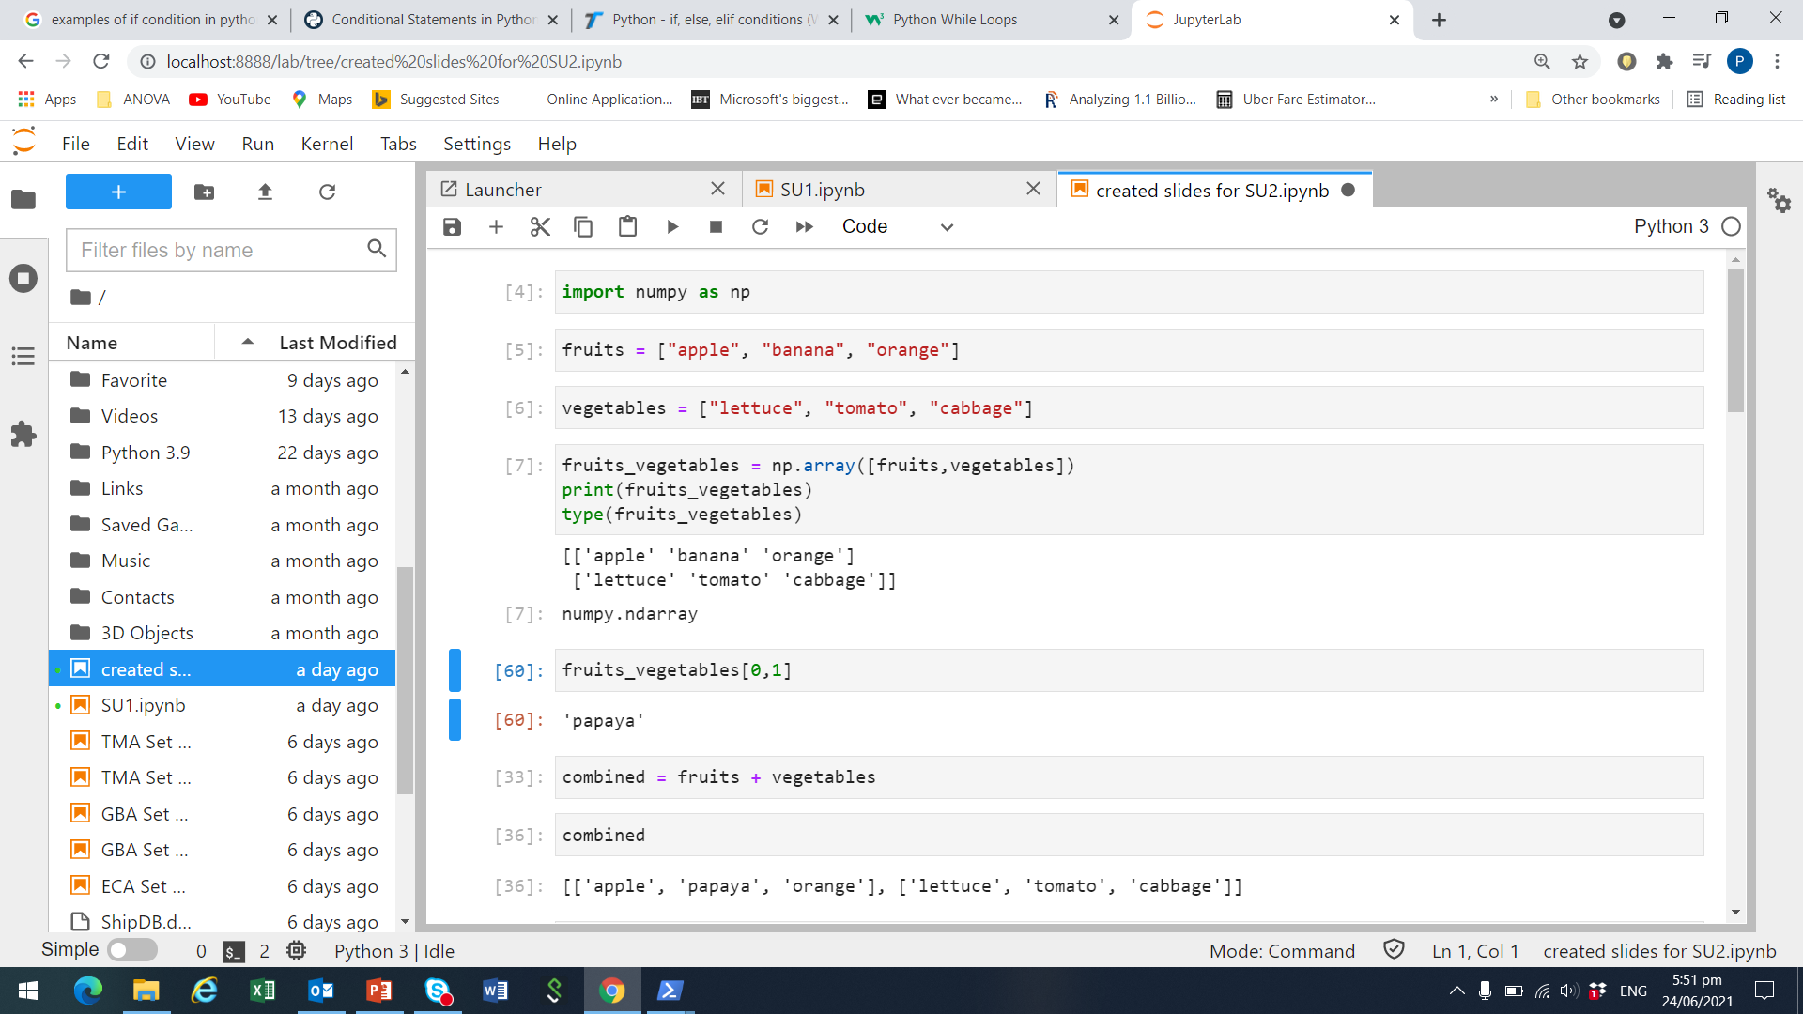
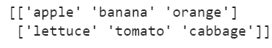
Example of 2 dimensional numpy array
Import packages
Suppose we have two lists, fruits and vegetables
Combine fruits and vegetables into one numpy array
Print the array to take a look at its contents

Slide 7
Subset Arrays
Use index operator [] to access elements of an array.
Two ways to subset an array:
By index: Including multiple indexing, open-end indexing, negative indexing.
Boolean masking: Values of an array that fulfil certain conditions are selected in the subset.
Syntax for subsetting two-dimensional arrays:
The order of the indices in the index operator must follow the sequence of the axes (dimension).
array_name[row_index, column_index]

Slide 8

Subsetting example
In our example, we created fruits_vegetables as a numpy array.
Row index: 0 is the fruits list, 1 is the vegetables list
Column index: 0 is the 1st element in a given list, 1 is the 2nd element…
To get ‘banana’ from fruits_vegetables, we need
row index = 0 (i.e., fruits list) and,
column index = 1 (i.e., 2nd element)

Slide 9
Array Properties
Check properties of an array using some NumPy functions and methods:
type(array_name)
array_name.ndim
array_name.shape
array_name.size
array_name.dtype

Slide 10
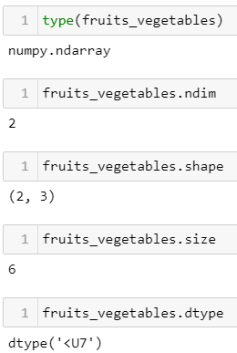
Example of array properties

Slide 11
Example Program for Students
Create a NumPy array of age_heights of three people.(the first row on ages, the second row on heights).
For the array that you just created, how is the dimension, shape, size, and datatype?
Subsetting of array: Please only print the heights.

Slide 12
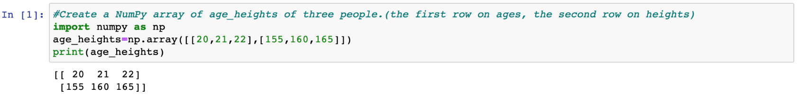
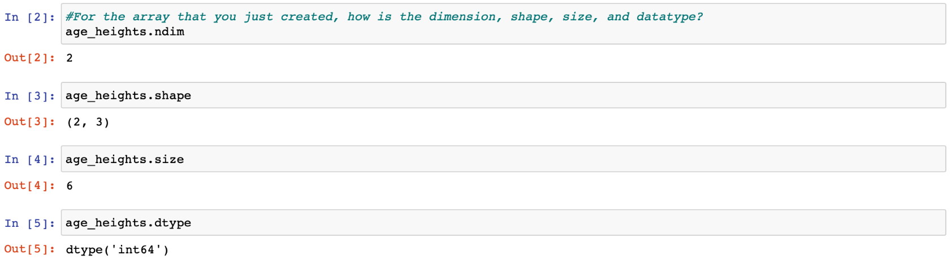
Example Program (Answers)
Create a NumPy array of age_heights of three people.(the first row on ages, the second row on heights).
For the array that you just created, how is the dimension, shape, size, and datatype?
Subsetting of array: Please only print the heights.

Slide 13
Example Program for Students
Mean Value – Please do research on Numpy!
Calculate the mean value of the Numpy array: age_heights
Calculate the mean value of the age of three people
Calculate the mean value of the heights of three people
Notes:
Google ‘Python numpy mean’: https://numpy.org/doc/stable/reference/generated/numpy.mean.html
When you learn Python as a programming language, one very import thing is to conduct some research by yourself, use the search engines like Google. You can always see a lot of related materials. In the future, when you work in the industry, there must be a lot of things that have not been covered in this course, because I only have six weeks to teach you some basic things about Python. It is very important for you to have the ability to do the self study and search online.

Slide 14
Example Program (Answers)
Mean Value – Please do research on Numpy!
Calculate the mean value of the Numpy array: age_heights
Calculate the mean value of the age of three people
Calculate the mean value of the heights of three people
Notes:
Google ‘Python numpy mean’: https://numpy.org/doc/stable/reference/generated/numpy.mean.html
When you learn Python as a programming language, one very import thing is to conduct some research by yourself, use the search engines like Google. You can always see a lot of related materials. In the future, when you work in the industry, there must be a lot of things that have not been covered in this course, because I only have six weeks to teach you some basic things about Python. It is very important for you to have the ability to do the self study and search online.

Slide 15
Work with NumPy Arrays
NumPy provides various functions to us to work with arrays.
Each function deals with specific type of values in the array.
For instance, log() and sqrt() are only applicable to numeric arrays.
Functions like strip() and upper() are specifically designed for strings arrays.
Each function may have effect on different axes of the array.
Below are some examples of some frequently used NumPy functions.
Function | Description
percentile() | Return row, column, or array percentile
mean() | Return row, column, or array mean
exp() | Return exponential
random.ranf() | Return array with random floats in the interval [0, 1)

Slide 16
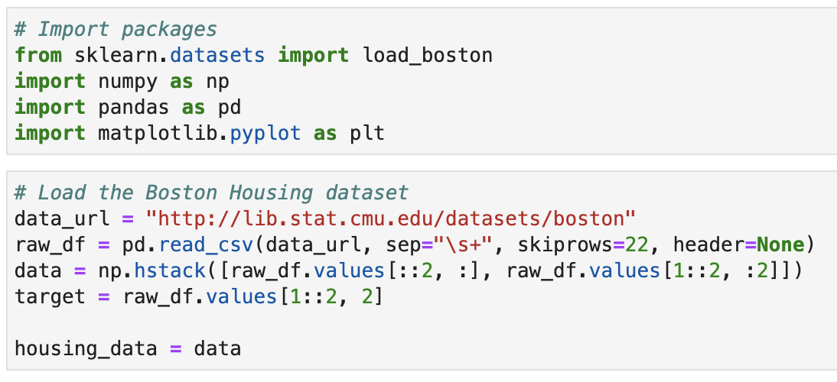
Activity 1
1) Compute the statistics for each column of the housing data
Extract the values for each column
Compute the min, max, mean, median and standard deviation of each column in the array
Load Boston Housing dataset:

Slide 17
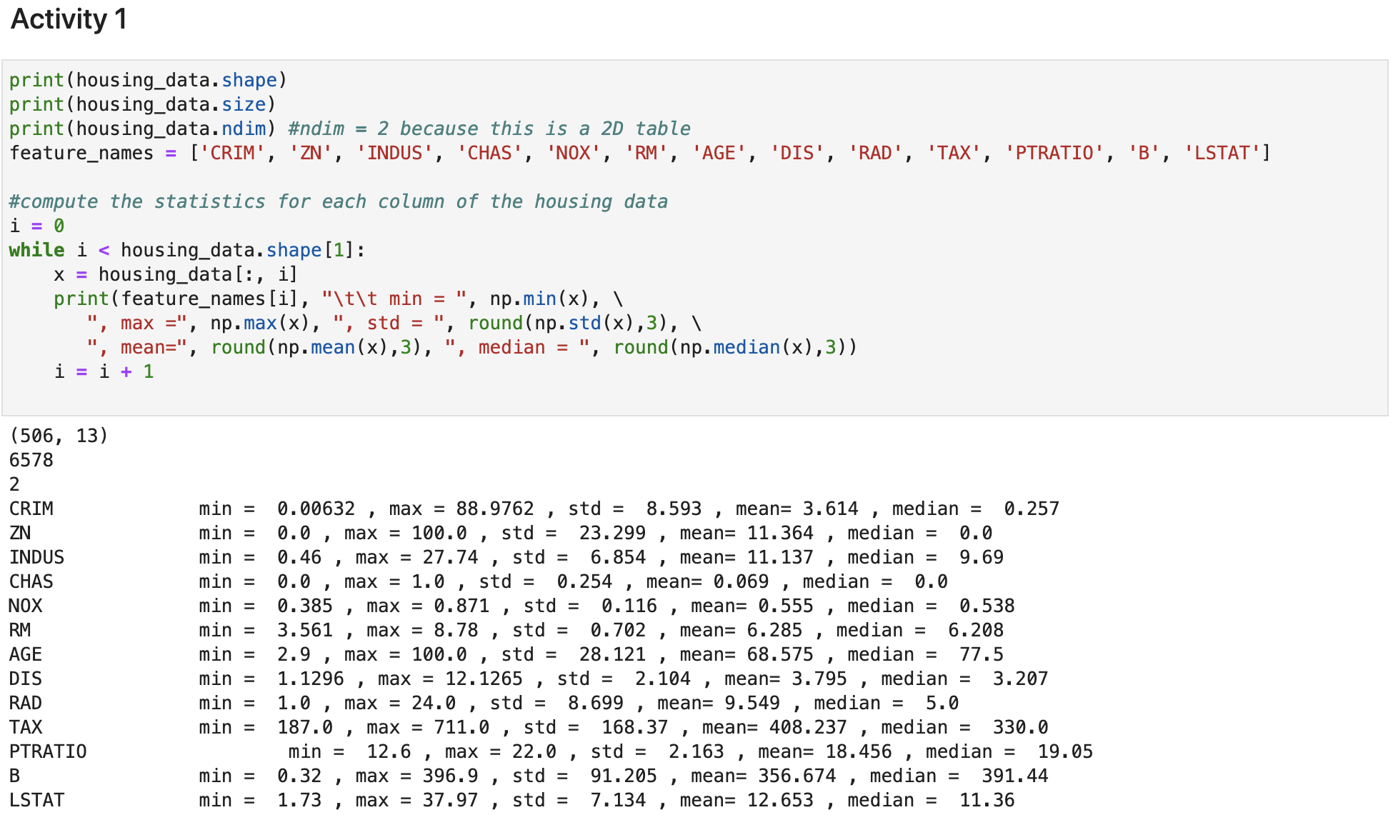
Activity 1 (Answers)

Slide 18
Discussion
When is it more sensible to use arrays instead of tuples, lists, or dictionaries? And when is it vice versa?
Why do some NumPy functions require the whole axis or array for its process and why some of them do not?

Slide 19
Discussion (answer)
When is it more sensible to use arrays instead of tuples, lists, or dictionaries? And when is it vice versa?
Use arrays when we have multi-dimensional objects
Why do some NumPy functions require the whole axis of array for its process and why some of them do not?
Depends on what we are calculating. E.g., mean of a column vs the mean of an array

Slide 20
Plotting with matplotlib

Slide 21
matplotlib Package
“matplotlib” is the most common visualisation package for Python.
The sub-package “pyplot” contains all functions and plot types we need here, e.g., bar chart, histogram, scatter plot, etc.
Use the following syntax to import “pyplot” into a program:
import matplotlib.pyplot as plt

Slide 22
Create Plots
Use plot() function to create simple line plot.
The function parameters control:
x, y: lists of the x-axis and y-axis values
color: colour of the line
linestyle, linewidth: formatting options of the line.
marker: style of the data points, e.g., point, circle, square, etc.
markerfacecolor, markeredgecolor and markersize: colour and size of data points.
Refer to https://matplotlib.org/api/_as_gen/matplotlib.pyplot.plot.html for more arguments of the plot() function.
plt.plot(x, y, color, linestyle, linewidth, marker,
markerfacecolor, markeredgecolor, markersize)

Slide 23
Other Plot Options
Apply .xlabel() and .ylabel() methods to add labels to both axis.
Set a title to the current plot by title().
We can define the text and location of the labels on each tick of both axes.
Python waits for show() to display all figures.
plt.xlabel("My X-Label String")
plt.ylabel("My Y-Label String")
plt.title("My Plot Title")
plt.xticks(ticks, labels, rotation)
plt.yticks(ticks, labels, rotation)
plt.show()

Slide 24
Histogram
Histogram shows the distribution of a variable.
With the hist() function, we can control
number of bins,
range of values,
chart’s orientation,
width of the bars,
position of the bars (between two ticks or on top of a tick),
colour of the bars.
plt.hist(x, bins = None, range = None, align = "mid", orientation = "vertical", rwidth = None, color = None)

Slide 25
Scatter Plot
Scatter plots are used to study the correlation between two variables.
The parameters of the scatter() function control
values of x and y,
colour and style of the markers,
width and colour of the markers’ edge.
plt.scatter(x, y, color = None, marker = None, linewidths = None, edgecolors = None)

Slide 26
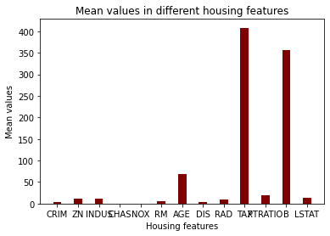
Activity 2
2) Plot a bar graph showing the mean values of houses in different housing features as shown

Slide 27
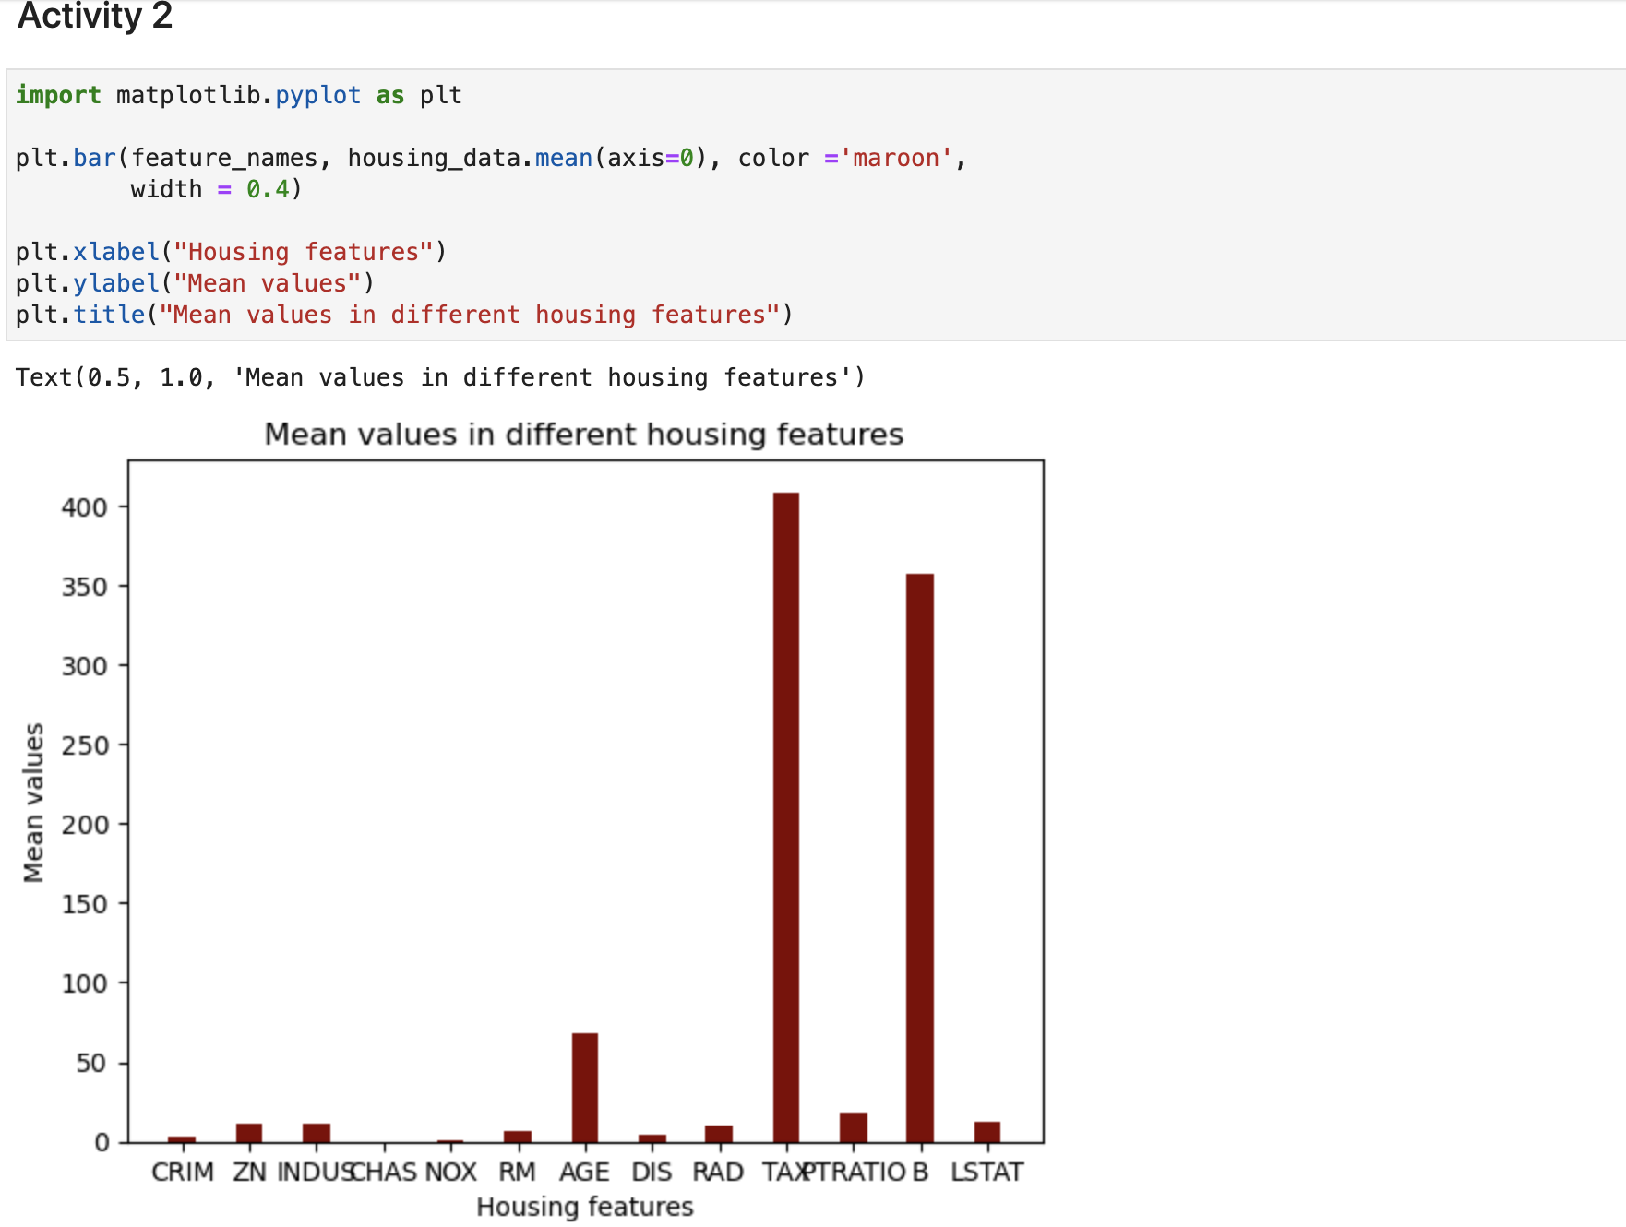
Activity 2 (Answers)

Slide 28
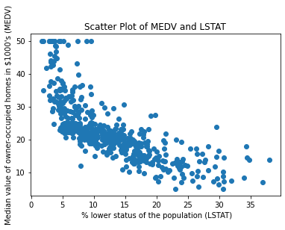
Activity 3
3) Plot a scatter plot showing the % lower status of the population (LSTAT) and Median value of owner-occupied homes in $1000's (MEDV)

Slide 29
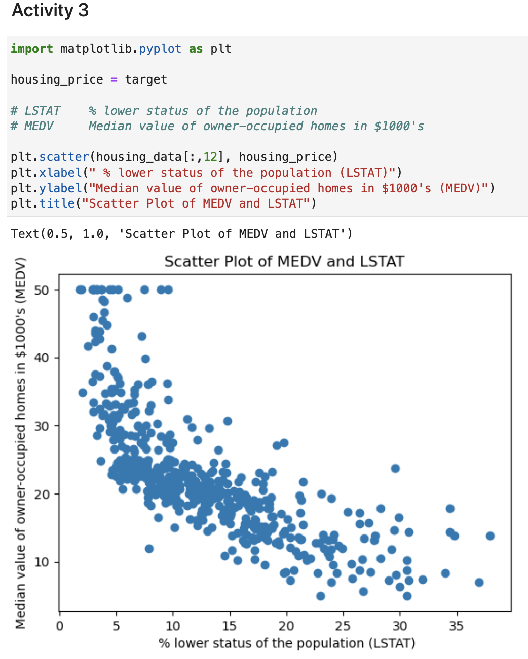
Activity 3 (Answers)

Slide 30
Activity 4
Revisit the earlier plotting exercises on the housing dataset:
Find at least one modification to improve each of any two plots done earlier
Discuss what you have found

Slide 31
Discussion
What are the additional matplotlib functions that can help us to improve the visualisation of our charts?
Name some situations in which a line chart, or a histogram, or a scatter plot is more suitable than other plot types for data visualisation.

Slide 32
Discussion (answers)
What are the additional matplotlib functions that can help us to improve the visualisation of our charts?
E.g., type of markers used, labels rotated, etc.
Name some situations in which a line chart, or a histogram, or a scatter plot is more suitable than other plot types for data visualisation.
Line chart: track changes in a variable over time
Histogram: interested only in a variable’s distribution
Scatter plot: relationship between two variables

Slide 33
Online Learning Platform (Optional)
Matplotlib Tutorial:
https://www.w3schools.com/python/matplotlib_intro.asp

